Slide 1
DNSC 6303 - Programming for Analytics I
Optional Individual Assignment

Slide 2
Source of collected data
This excellent numeric dataset shows independent and dependent variables are:
Health premium received. (The only dependent variable)
The dependent variables are:
Patient Age
Diabetes
Blood pressure problem
Any transplants
Any Chronic disease
Patient’s weight
Patient’s height
Known allergies
I have taken the data from:
The dataset used in Quiz 1. Name: payor(1).csv

Slide 3
Purpose
In the regression analysis we will focus into followings:
Loading the datasets
Importing libraries
Separating independent and dependent variables.
Splitting the dataset into ‘Train’ and ‘Test’ in to 80:20 ratio.
Model fitting
Estimating parameter results
Model diagnostics
Residual Analysis with QQ plot
Here we will build a predictive model for multiple regression analysis. Here y = Health premium and all others are independent variables (x).

Slide 4
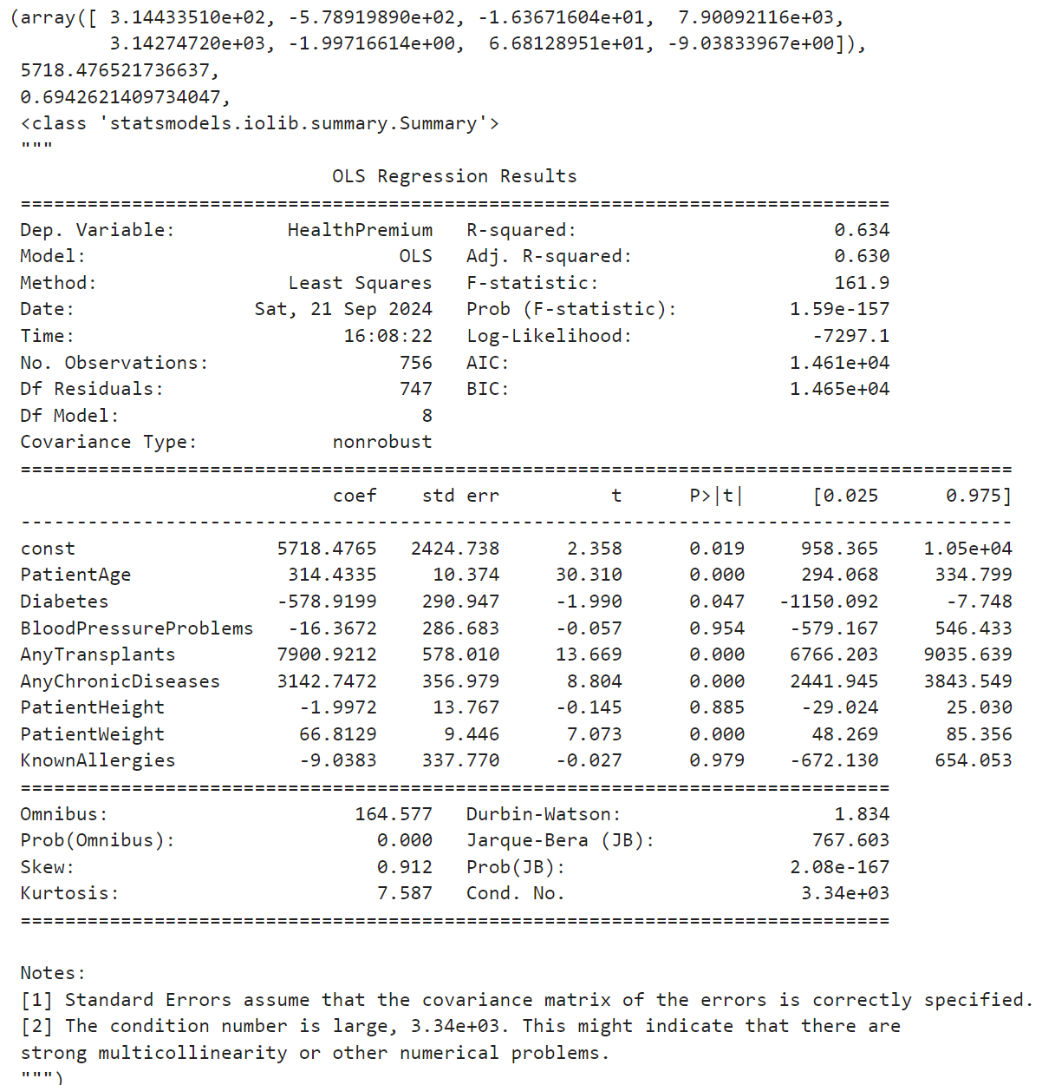
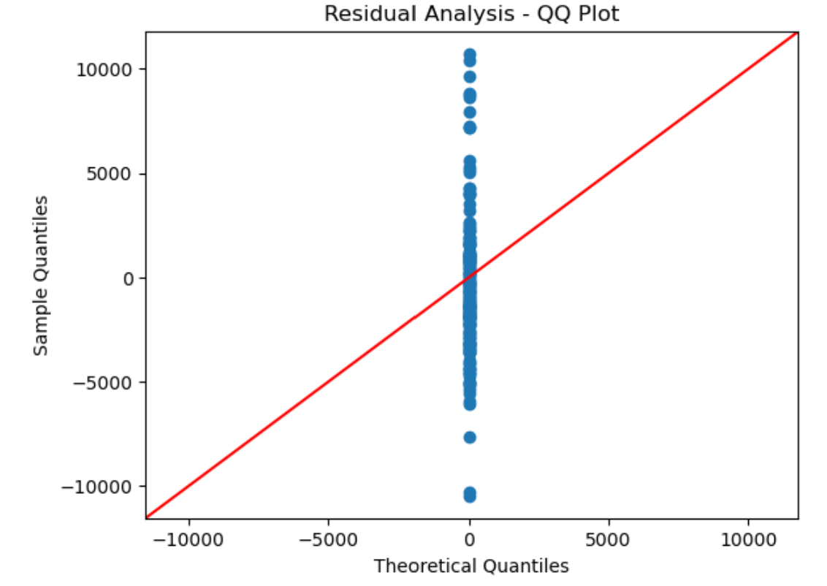
Results
Results

Slide 5
Insights & Conclusion
Age, Transplants, Chronic Diseases, and Weight are key drivers of health premiums.
Some variables like Blood Pressure Problems and Height do not significantly impact premiums.
The residual analysis shows that the residuals roughly follow a normal distribution.
The model’s R-squared value of 0.694, a reasonable fit, for the test set indicates that 69.4% of the variation in health premiums can be explained by the independent variables.
Blood Pressure Problems, Patient Height, and Known Allergies have insignificant coefficients.

